Slide 1
Theerthesh C Assesment
File created on: 7/17/2021 8:00:28 PM

Slide 2
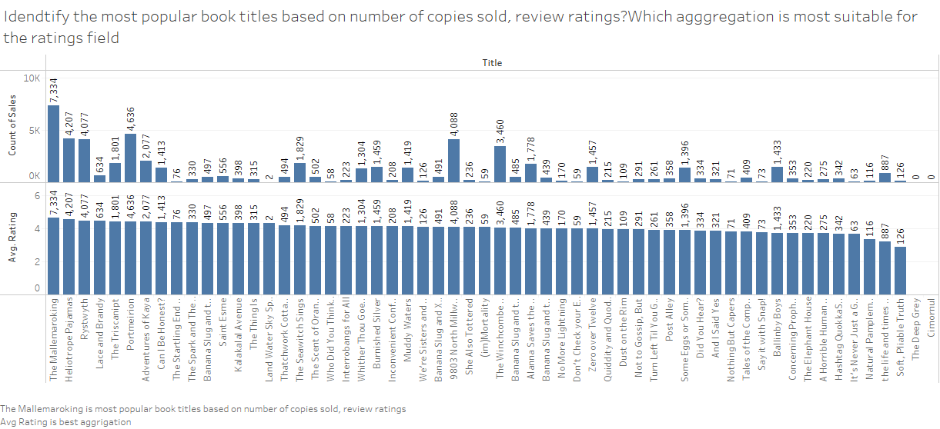

Slide 3
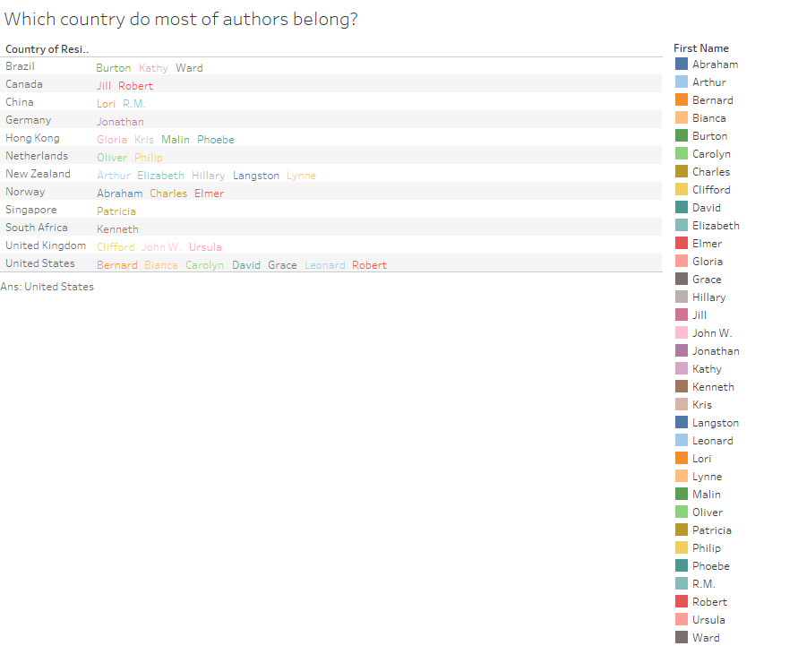

Slide 4
